Slide 1
Montaigne as Mayor of Bordeaux: Mapping a Political Network
Eszter Kovács
NKE EJKK PÁK

Slide 2
Montaigne’s career
Member of the Parlement de Bordeaux until 1570: legal career
1570-1580: Château de Montaigne
1580-1581: travel to Italy, cure or diplomatic ambition?
1581-1583, 1583-1585: Mayor of Bordeaux, succeeded by Matignon
After 1585: negotiator between Henri III and Henri de Navarre

Slide 3
“Of husbanding our will” (Essays, III, 10)
“Le maire et Montaigne ont toujours été deux, d’une séparation bien claire.”
“The mayor and Montaigne have always been two, with a very clear separation.” (trans. by Donald Frame)
“Si quelquefois on m’a poussé au maniement d’affaires estrangieres, j’ay promis de les prendre en main, non pas au poulmon et au foye ; de m’en charger, non de les incorporer ; de m’en soigner ouy, de m’en passionner nullement : j’y regarde, mais je ne les couve point.”
“If people have sometimes pushed me into the management of other men’s affairs, I have promised to take them in hand, not in lungs and liver; to take them on my shoulders, not incorporate them into me; to be concerned over them, yes; to be impassioned over them, never. I look to them, but I do not brood over them.” (trans. by Frame)
“If I have sometimes been persuaded to involve myself in the affairs of others, I have promised to take them in hand, not into the lungs and stomach; to shoulder them, not to ingest them; to pay attention to them, yes; to take a passionate interest in them, never. I keep an eye on them, but I do not coddle them.” (trans. proposed by Philip Stewart)

Slide 4
Local self-government, custom and tradition
”lived a life apart, with their own fashions, dress and habits, ruled and governed by certain particular systems and customs, handed down from father to son, to which they bound themselves with no other constraint than that of reverence for their practice. This little state had continued from all antiquity in so happy a condition that no neighboring judge had been put to the trouble of inquiring into their doings, no lawyer retained to give them counsel, no foreigner ever called in to settle their quarrels; and no one of this district had ever been seen begging. They avoided marriages and dealings with the outer world, so as not to corrupt the purity of their government, until, so they tell, one of them, within the memory of their fathers, whose soul was spurred by noble ambition, took it into his head, in order to bring his name into credit and reputation, to make one of his sons Maître Jean or Maître Pierre, and having sent him to some neighboring town to learn how to write, finally made him into a fine village notary. This son, having become important, began to disdain their ancient customs and to put into their heads the notion of the pomp of the regions on this side of the mountains. The first of his cronies whose goat had a horn broken off he advised to demand justice from the royal judges near by; and he went on from this one to another until he had debased to whole place.” (tale of Lahontan, II, 37, trans. by Donald Frame)

Slide 5
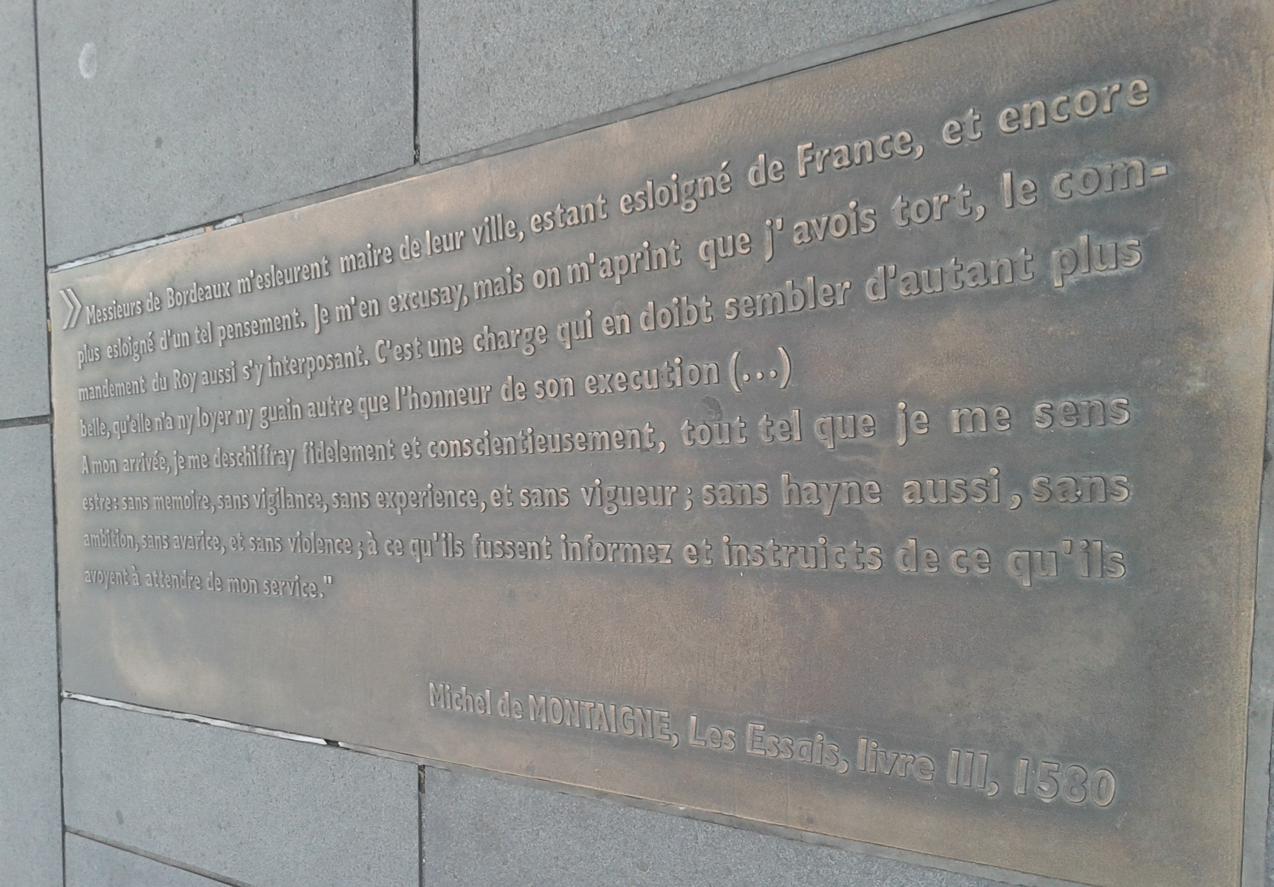
Messieurs de Bordeaux m’esleurent maire de leur ville

Slide 6
End of the mandate
Conflicts in Guyenne, plague in Bordeaux
Next mayor: Matignon
“Some say about this municipal service of mine […] that I went about it like a man who exerts himself too weakly and with a languishing zeal; and they are not at all far from having the case. […] People also say that my administration passed without a mark or a trace. That’s a good one! They accuse me of inactivity in a time when almost everyone was convicted of doing too much.” (III, 10, trans. by Frame)
“I would spare neither life nor any other thing for your service; but I will leave you to judge of what use my presence would be at the approaching election before venturing to come into the city, considering the bad state in which it is, especially dangerous to people who come from such good air as I do.” (Letter to the jurats, 1585, trans. by Charles Cotton)

Slide 7
Debates about Montaigne’s role as mayor
Katherine Almquist (1968–2012): need to write a pluralist biography
Jean Starobinski: aptitude to political negotiation and not political struggle
Philippe Desan: Montaigne’s unfulfilled ambitions
Anne-Marie Cocula: Montaigne, a key figure in Guyenne
Biancamaria Fontana: “low-key performance” as mayor, not a proof for Montaigne’s so-called political conservativism

Slide 8
Network research?
Local network vs. extended network
How to structure data on people? origin, religion, group, alliance?
How to exploit datasets?
Biographical studies (causality) vs. network (patterns)
Is quantification possible? Katherine Almquist tried to quantify Montaigne’s legal activity in the Bordeaux Parliament
Interrelation vs. quantification

Slide 9
Network research – first phase
Creation of a namespace of Montaigne’s local network and of his higher network
Tool proposed: Opentheso (free, opensource, under further development, using persistent identifiers, used by several French projects in humanities)

Slide 10
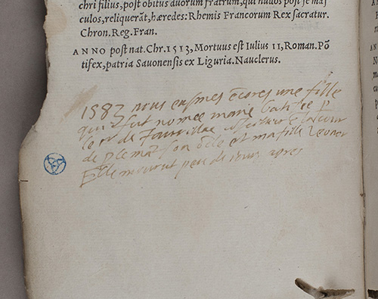
Thank you for your attention.
Montaigne, Éphémérides, 21st February 1583
« nous eûmes encore une fille qui fut nommée Marie […] Elle mourut peu de jours après »

